Slide 1
You Only Look Once:
Unified, Real-Time Object Detection
Joseph Redmon, Santosh Divvala , Ross Girshick, Ali Farhadi
By:
Fida Hussain Abbas Rao (ME-18064)
Hammas Amir Khan (ME-18063)

Slide 2
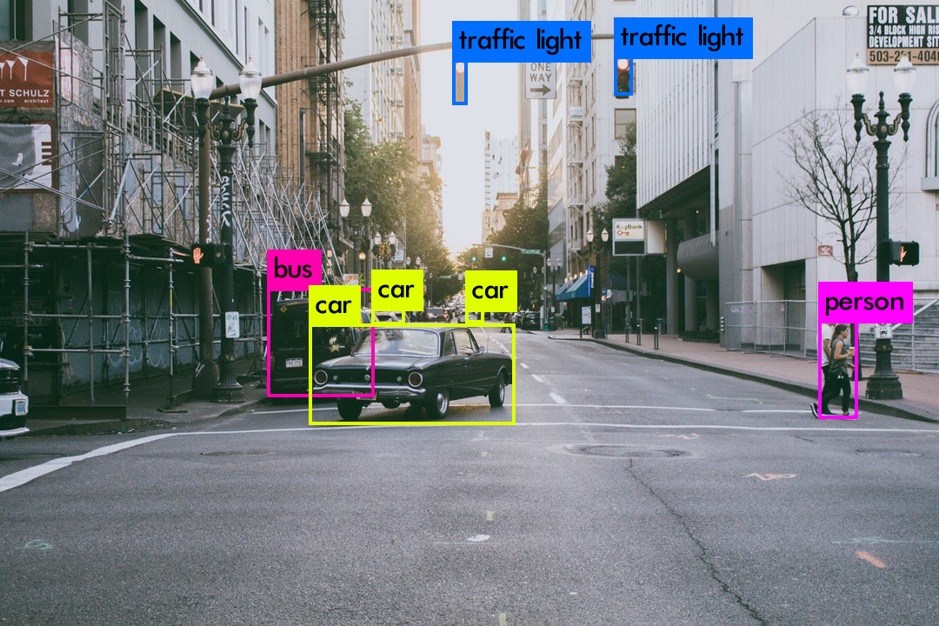
Introduction
What is Object Detection?
Classify the object
Get the boxes around the object

Slide 3
Comparison of Previous object detectors with YOLO
 | Pascal 2007 mAP | Speed | Processing time
DPM v5 | 33.7 | .07 FPS | 14 s/img
RCNN | 66.0 | .05 FPS | 20 s/img
Fast RCNN | 70.0 | .5 FPS | 2 s/img
YOLO | 63.4 | 45 FPS | 22 ms/img

Slide 4
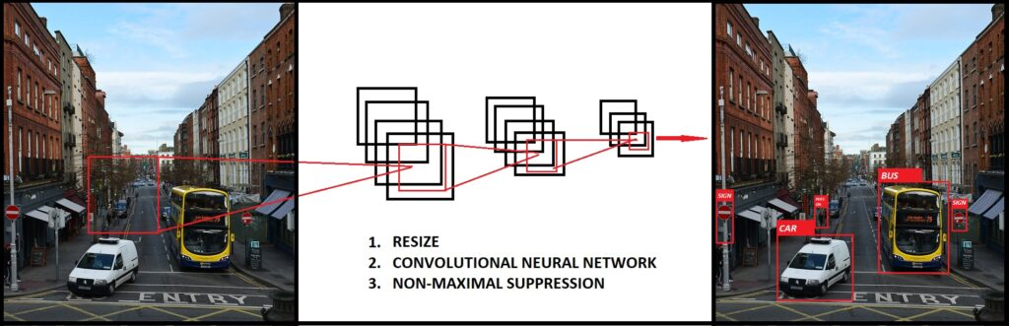
Why is YOLO faster than the previous object detectors?
With YOLO, you only look once at an image to perform detection.
Previous object detection methods such as DPM and RCNN used to look at the image hundreds of thousands of time to perform detection

Slide 5
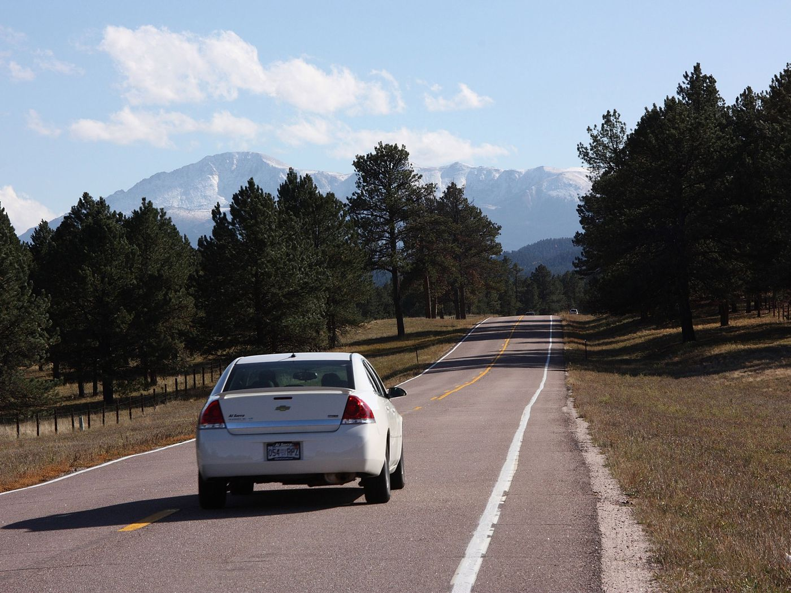
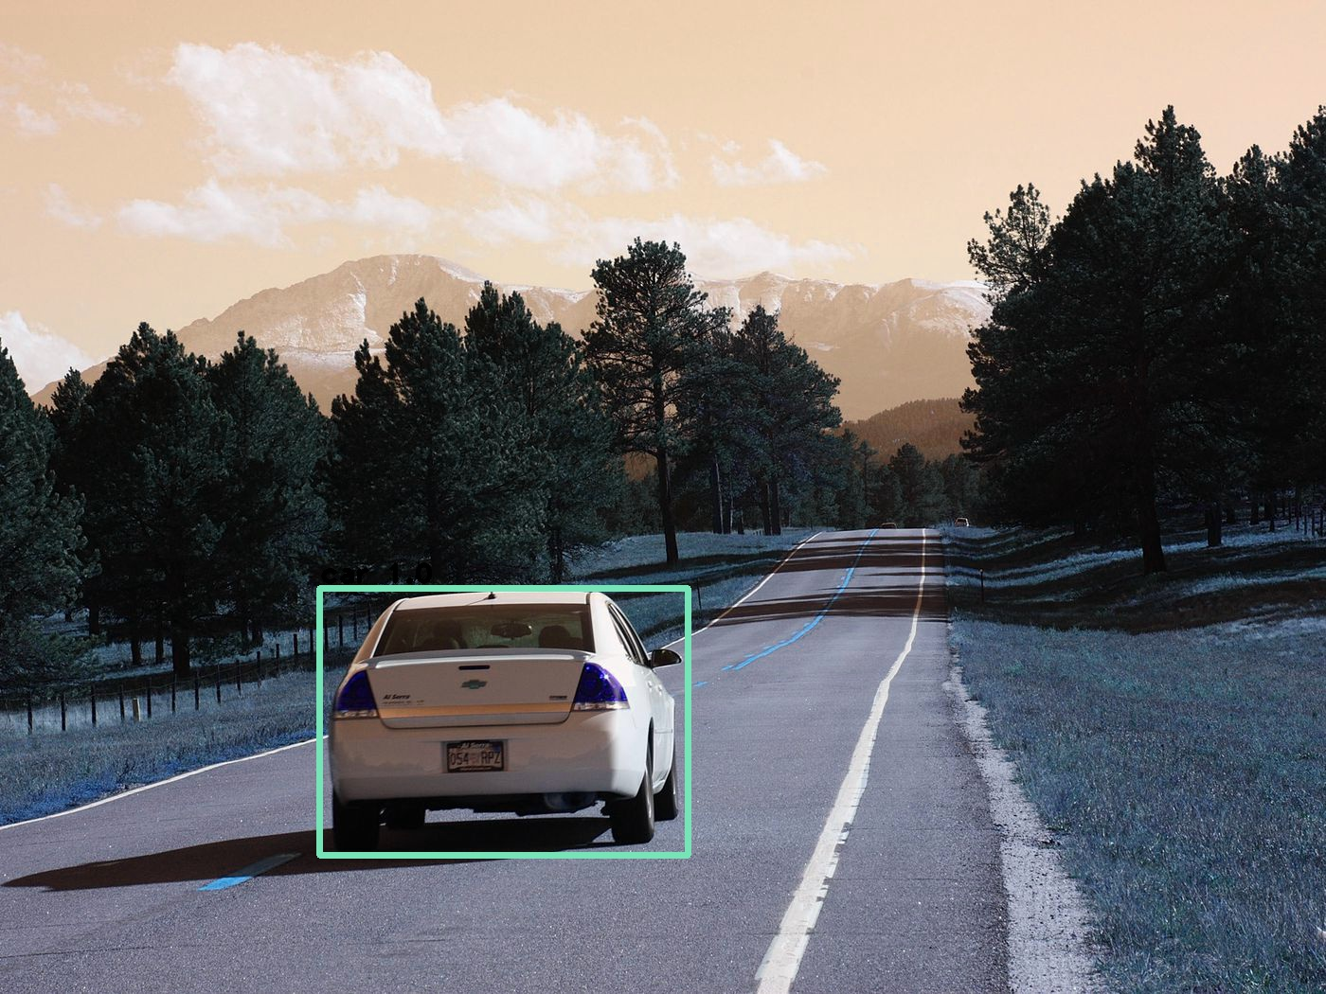
Components of Object detection
Image Classification
Classify the object in the image
Image Localization
Classify the object in the image
Predict the position of the bounding box
Label = ‘Car’

Slide 6
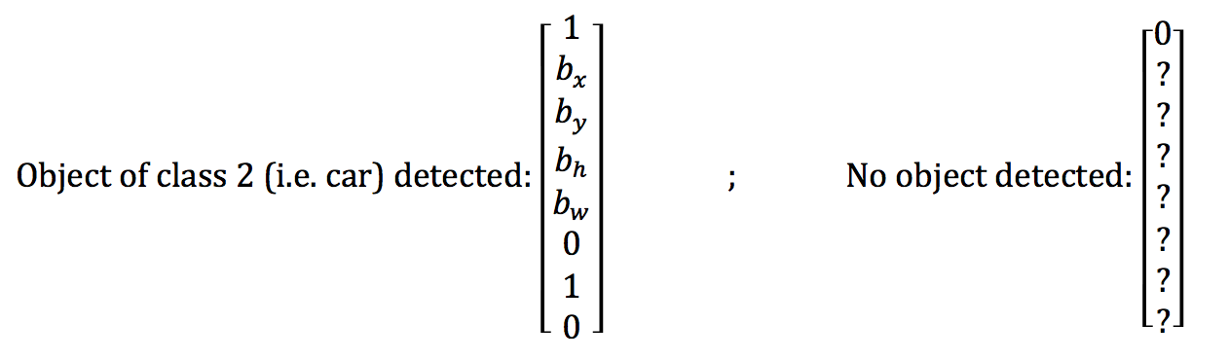
How to interpret the bounding box vector?
Size of bounding box is 1x(5+num classes).
Pc
bx
by
bh
bw
C1
C2
C3

Slide 7
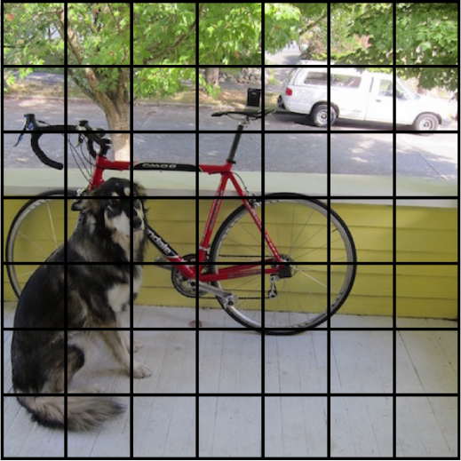
Object Detection with YOLO
Overlay a grid of size SxS cell
Grid with center point is responsible for detecting that object.
Perform image classification and localization for all the grid cells.

Slide 8
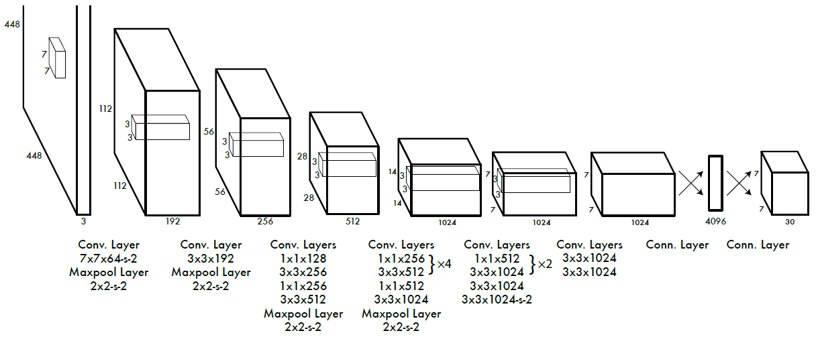
Training the model
Collect Data
Gather plenty of images (X_train)
Respective bounding boxes (y_train)
Train a Convolutional Neural Network
24 layers of convolutions
2 fully connected layer
Use stochastic gradient descent optimizer
Evaluate the model on unseen data

Slide 9
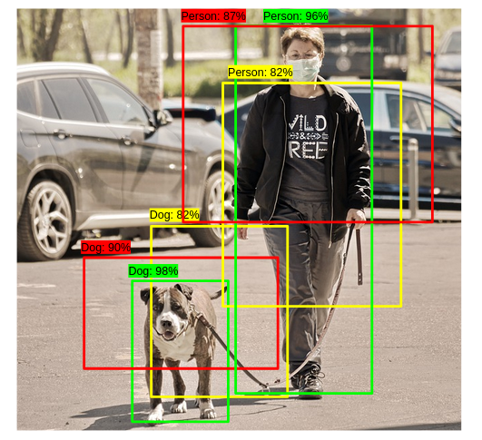
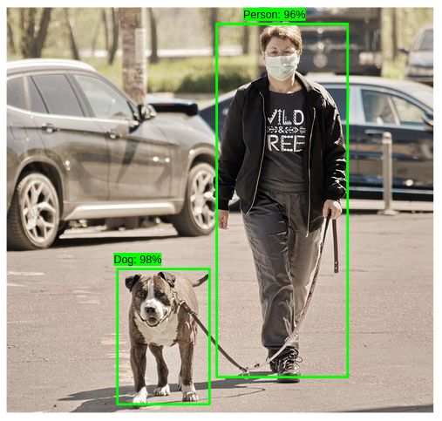
How to get rid of multiple detections per object?
Select box with the highest confidence score
Compute IOU of all other box with the chosen box
Remove boxes with IOU higher than the threshold
Repeat the above steps until we obtain one detection per object

Slide 10
Summary of YOLO’s Working
Train the model
Evaluate the model
Getting the predictions on desired image
Filter out boxes with no object (pc < 0.5)
Apply Non-max Suppression to get rid of multiple detections per object

Slide 11
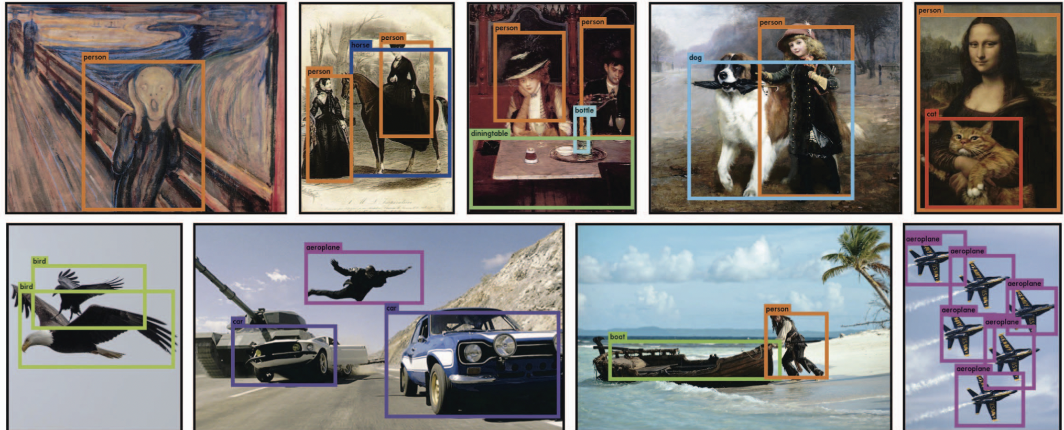
How does the model perform?

Slide 12
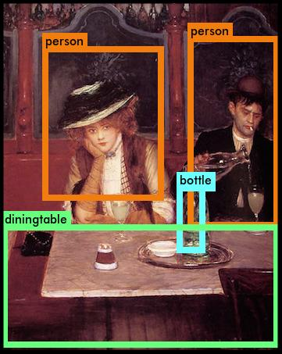
YOLO generalizes well to new domains (like art)
What is generalizability?
How does YOLO compare in terms of generalizability with the previous object detection methods?

Slide 13
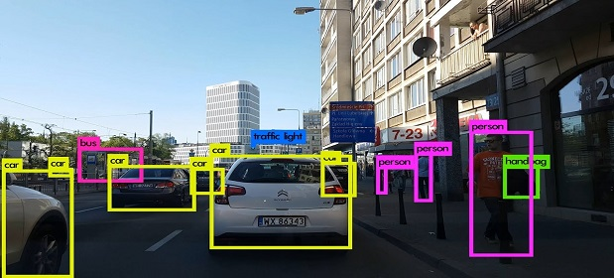
Applications of Object detection in real world
Vehicle detection in self driving cars
Automated CCTV surveillance
Cancer detection
Object Tracking

Slide 14
Thank You for your
attention!

